Slide 1
Good afternoon, my name is Ezra also known as the scribe let me tell you about myself…..
Scene 1

Slide 2
DESCENDANT OF AHARON HACOHEN/ TRIBE OF LEVI
“A SCRIBE OF THE LAW OF THE G-D OF HEAVAN”
A SCHOLAR AND A TEACHER.
BORN IN BABYLON/PERSIA
JOURNEYS TO YERUSHALAYIM AFTER THE REBUILDING OF THE BEIT HAMIKDASH
AUTHOR
OFFICER OF THE COURT OF KING ARTAXERXES

Slide 3
SCENE 2
IT IS THE YEAR 458 B.C.E.
KING ARTAXERXES DECREE TO EZRA……

Slide 4
THE DECREES
EZRA IS PERMITTED TO RETURN TO HIS HOMELAND WITH A MILITARY ESCORT
ANYONE MAY LEAVE WITH EZRA INCLUDING THE LEVIIM AND COHANIM
THE JEWISH PEOPLE MAY TAKE GOLD AND SILVER CONTRIBUTIONS TO THE BEIT HAMIKDASH
THE KING DONATES TO THE TEMPLE SERVICE(SILVER, WINE, WHEAT, OIL)
THE COHANIM AND LEVIIM ARE EXEMPT FROM TAXES
EZRA IS APPOINTED CHIEF JUDGE OF THE JEWS AND GIVEN AUTHORITY TO ENFORCE DECISIONS..

Slide 5
SCENE 3
KING ARTAXERXES SAYS, MY REASONS FOR SENDING EZRA ARE…..
1.----------------------------------------
2.----------------------------------------
3.----------------------------------------

Slide 6
3 REASONS KING ARTAXERXES SENT EZRA TO ENFORCE JEWISH LAW:
THEOLOGICAL:
ACCORDING TO EZRA HASHEM INSPIRED ME
HISTORICAL:
TO ENFORCE LAW IN JUDEA IN ORDER TO STRENGTHEN MY HOLD IN EGYPT
POLITICAL:
EZRA REPLACED THE ROYAL FAMILY SO THERE WOULD BE NO THREAT OF A REBELLION.

Slide 7
SCENE 4
DURING MY (EZRA) JOURNEY….

Slide 8
MY JOURNEY
1496 JEWISH PEOPLE
38 LEVIIM
220 SERVANTS
JOIN EZRA
EZRA RELIES ON HASHEM..DOES NOT TAKE A MILITARY ESCORT
TAKES 4 MONTHS

Slide 9
SCENE 5
WHEN I GET TO YERUSHALAYIM I (EZRA) FIND…

Slide 10
UPON ARRIVING TO YERUSHALAYIM EZRA FINDS…
VERY LITTLE TORAH LEARNING
DIFFICULT LIVING CONDITIONS
INTER-MARRIAGE
LOW LEVELS OF RELIGIOUS OBSERVANCE

Slide 11
SCENE 6
I (EZRA)
TAKE ACTION BY…..

Slide 12
EZRA TAKES ACTION:
☑
PUBLIC ASSEMBLY IN YERUSHALAYIM
☑
GIVES MUSSAR TO THE JEWISH PEOPLE AND INFLUENCES THEM TO MAKE TESHUVAH
☑
ENCOURAGES THE MEN TO SEPARATE FROM THEIR NON -JEWISH WIVES
☑
SENT SOFRIM TO TEACH THE COMMUNITY

Slide 13
To sum it up…
The Jewish people were on the verge of assimiliation and self destruction.
The Jews didn’t feel Jewish pride.Ezra rallied the people and enforced the supremacy of Torah
He revitalized Jewish life.
He changed the course of Jewish History.

Slide 14
ITS ME ..NEHEMIAH its 445 bce

Slide 15
I ASKED THE KING PERMISSION TO GO TO JUDEA AND REBUILD THE WALL AROUND THE CITY
THE KING AGREED AND APPOINTED ME GOVERNOR OF JUDEA
445 BCE
I LEFT WITH A MILITARY ESCORT AND PLENTY OF TIMBER TO BUILD THE WALL AND TEMPLE CITADEL
I ARRIVE IN JUDEA SECRETLY AT NIGHT

Slide 16
WHY DID KING GRANT HIM PERMISSION TO LEAVE?

Slide 17
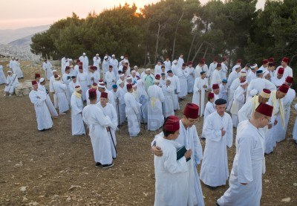
BOY DID I HAVE A PROBLEM
THE SAMARITANS!

Slide 18
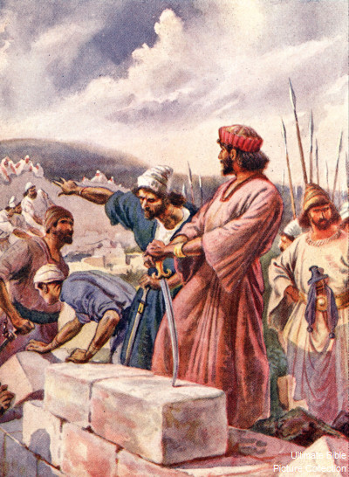
I continue to inspire the Jews to help rebuild the wall!
The laborers held weapons in one hand fighting off the enemies and used their other hand to build the wall
Mission accomplished:
Rebuilt city wall in
52 days

Slide 19
16 ft high,4.5 miles around 2000 inches deep

Slide 20
Nehemiah takes action as a political leader:

