Slide 1
Jewish History
Babylonia through the rise of Rome
586bce-63 bce

Slide 2
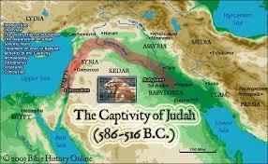
destruction of the first Beit Hamikdash -586 BCE
Beit Hamikdash is burned by Nebuchadnezza
אם אשכחך
ירושלים
Beit hamikdash is destroyed and all Judea is exiled to babylonia.

Slide 3
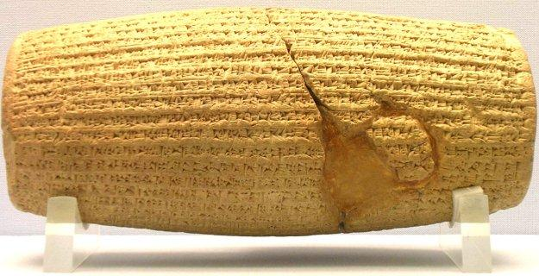
King Cyrus Decree
By: Rachel Dabah
Was written in Akkadian cuneiform script.
the cylinder is 22.5 centimeters x 10 centimeters.
The Decree
All jews are allowed to go back to Judea and rebuild the temple.
Cyrus gave the jews back the gold and silvers that nebuchadnezzar took from the jews.
This was said to be a miracle, that cryrus’ god marduk came to him in a dream and told him to make this decree.
king cyrus was king of Persia. He ruled over the jews in the most human way than any other king.
king cyrus wrote his decree in 538 BCE on a small piece of baked clay shaped as a cylinder.

Slide 4
Shesshbesar , Zerubavel, and the first Aliyah
When zerubavel laid the foundation of the temple,the elders cried tears of sadness because they felt it wouldn’t compare in glory to the first.
The Jews of Bavel
(mostly the poor)
journeyed back to
Judea with high hopes
to rebuild the temple.
They faced desolate land, difficult living conditions, and trouble from the samaritans.
In 516 bce the 2nd temple was finally rebuilt.

Slide 5
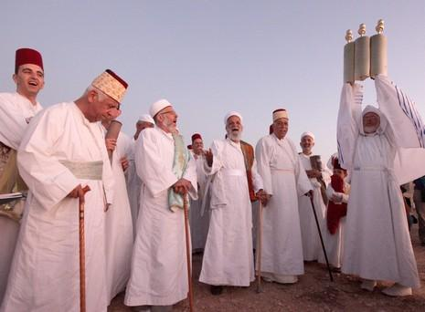
The samaritans
The Samaritans had developed their own compromised version of Judaism.
The Samaritans still believed in the God of the Jews, but they worshiped at Mount Gerizim.
The Samaritan religious community still exists today.
The Jews ultimately destroyed the Samaritan temple in 128 bc.
The samaritans ancestors cannot be traced.
In the mid 6th century The samaritans wanted to help rebuild the second beit hamikdash but zerubavel didn’t allow them too because he feared their foreign influenece.

Slide 6
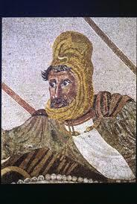
The Story of Purim
Ahashverosh had a party in persia and he killed his wife because she refused to come.
Ahashverosh had to look for a new wife so he sent out people to gather up all the pretty girls.
Esther was a jewish girl who lived with her uncle mordechai. She hid from the people every time they would come, but one day they found her.
When they brought her to Ahashverosh, he picked her right away because she was beautiful.
Esther had to hide the fact that she was jewish because the kings assistant haman wanted to kill all the jews.
Haman made a raffle to find out what day he will be killing the jews and he took the kings ring to stamp it and then they sent it out all the jews were scared.
Esther had a different maid everyday and she named them a name for everyday of the week so she knew when friday was coming.
One day mordechai wanted to sneak into the palace to talk to Esther and he overheard 2 men talking about wanting to kill the king so mordehai told king Ahashverosh and he killed them right away, because he killed them he told the king he was rewarded with a prize. the prize was chosen by haman because he thought the prize was for him but it turns out being the opposite.
It came to the day when haman wanted to kill the jews so esther fasted and made all the other jews fast and instead of the jews dying haman died.
The son of esther and ahashverosh was darius. king darius helped build the second bet hamikdash.

Slide 7
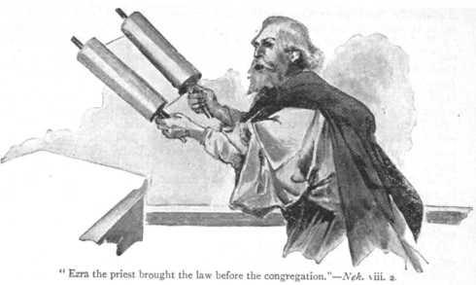
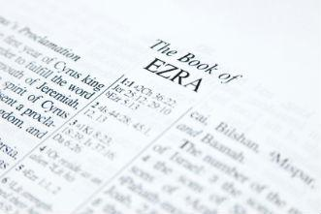
Ezra:480-440 C.E, By: Adina Edery
Ezra was also called Ezra the scribe
He was from the family of cohen.
his birth place: Babylon (Iraq)
Artaxerxes gave ezra permission for the jews to go with him to Jerusalem.
He was permitted to bring gold, silver and donations he got from other jews.
Ezras mission was to “expound the law of the lord”and to teach laws and rules to israel.
Ezra was the head of the great assembly.
He told the jewish men to divorce their foreign wives
He assembled the jews and read from the Torah in order to inspire them.

Slide 8
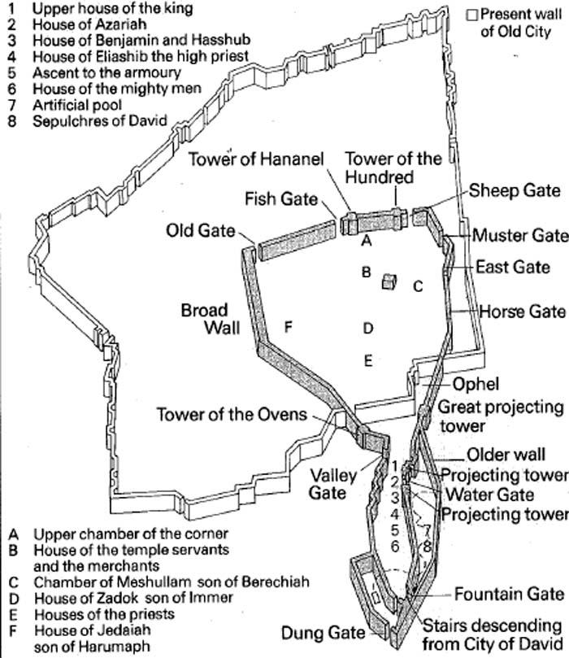
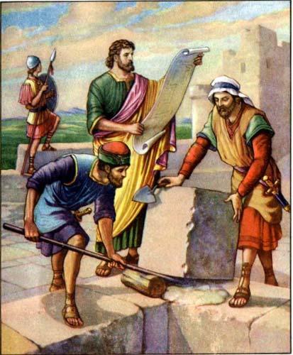
- In 445 B.C.E. , Nehemiah was a political leader who asked the King to go to Judea to rebuild the wall around the city.
- Left to Judea with a military escort and supplies to build the Wall and Temple Citadele, and secretly arrived to Judea at night.
- The Jews were afraid to rebuild the wall because of the Samaritans.
- Nehemiah pushed the Jews to rebuild the Wall while fighting off the Samaritans in one hand and building in other.
- It was a success! The Jews then built the wall in 52 days!
^{BY: LAUREN JEMAL}

Slide 9
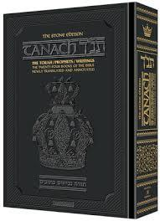
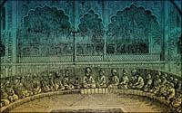
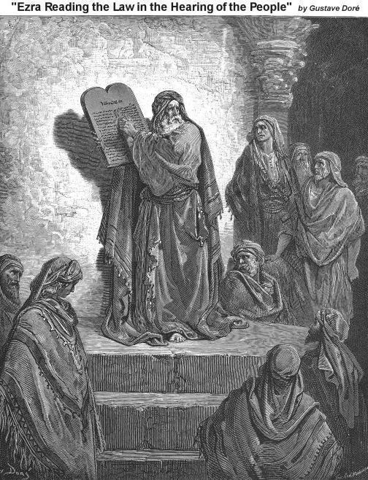
Anshei Knesset Hagedolah
BY:LAURIE SROUR
The Men of the Great Assembly
Time period = during early second temple period.
Was composed of 120 great leaders.
They were necessary for the survival of the jewish people because they were weaker spiritually. They also needed guidance because there were no more prophets. And they needed to pass the oral torah and their traditions down.
Some of the leaders were prophets, including Ezra and Nehemiah, Mordechai, Zerubbabel, Haggai, Zechariah and Malachi.
Some of the important things they did to help the jewish people was they sealed the scriptures, instituted prayers, coordinated the jewish calendar, and established an educational system in the land of Israel.
They brought two political results. The first one is the absence of a monarch of davidic ancestry. The second one is the strengthening of the office of the high priest.

Slide 10
ALEXANDER MEETS THE JEWS
356-323 B.C.E By: Esther Bennaim
Alexander from Macedonia conquers the Persian empire.
according to the Talmud,alexander the great has a brief encounter with the jews.The samaritans encourage Alexander to destroy the Beit Hamikdash.
As he approaches them he sees shimon hazadik and bows down to him,for in his dreams,He had visions of the kohen promising him success in his battles.His whole attitude changes.
Alexander grants the jews permission to live according to the Torah,and grants exemption from taxes every seventh year.
As thanks, Jews that year name their babys “alexander”

Slide 11
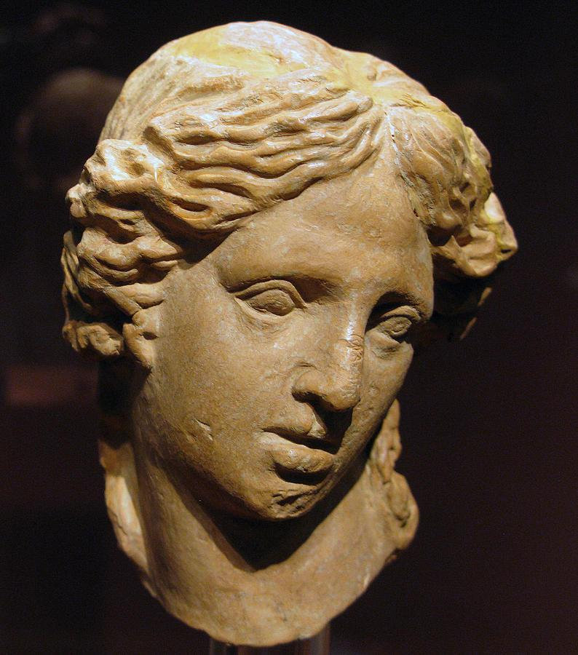
The Spread of Hellenism
Hellenism-the combination of Greek culture with other native cultures.
Hellenist- a jewish person adopting the Greek speech ideas or customs.
mid 4th century BCE
polytheistic
greek language
gymnasium- sport in the nude. idols alter for gods.
humanism- man is the center of the universe
Alexanders goal was to spread Hellenism across his empire, and that lead to it spreading to Judea.According to maccabees,Jason a Hellenized jew built a gymnasium in Jerusalem,and even the priests leave the temple to go to the gymnasium.Jews begin speaking Greek language and using Greek names.

Slide 12
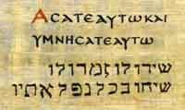
The Septuagint by Lilly Franco
The translation of the Torah into Greek language
Ptolemy II ordered the Septuagint sometime during his reign between 285-286 B.C.E.
He wanted to understand Jewish citizens because they were a big population in his empire.
Was doing a favor to the Jews since most Jews in Alexander spoke Greek.
Realized these five books were missing from his library.
Translated by the 72 sages from Judea.
The 72 sages all had the same exact translation of the torah which was a miracle.
Took place in Alexandria, Egypt.
Positive Negative
It allowed the greek some sages said
speaking jews to it brought 3 days
learn torah. of darkness onto
the world because
it exposed its
holiness to the rest of the world.

Slide 13
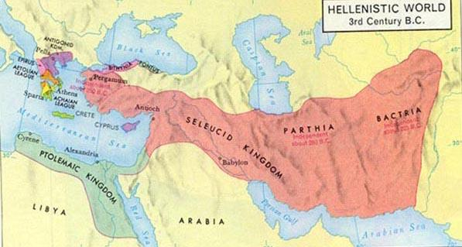
The Seleucid Empire
Takes Over Judea
198 bce
Antiochus III
Jews welcomed him
He allows the jews to live according to their ancestral laws

Slide 14
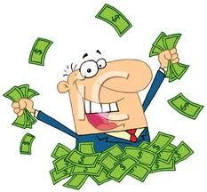
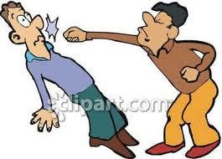
Jason and Menelaus
By: Rachel Gammal
Jason and Menelaus were both Hellenized Jews.
Jason was the high priest to King Antiochus until one day he sends Menelaus to deliver the money to the King in which he bribes the king to take the position of Jason.
Menelaus forced Jason to flee to the land of Ammon.
Menelaus was a greedy fellow who enforced all the people to pay high taxes that would go straight to him and not to the king.
When King Antiochus found out that he didn’t pay the King; Menelaus left his brother Lysimachus in charge while he was gone.
Menelaus went to the Temple and stole the gold dishes just to repay the King with.
Onias rebukes Menelaus for his actions, and Menelaus has onias arrested then killed.

Slide 15
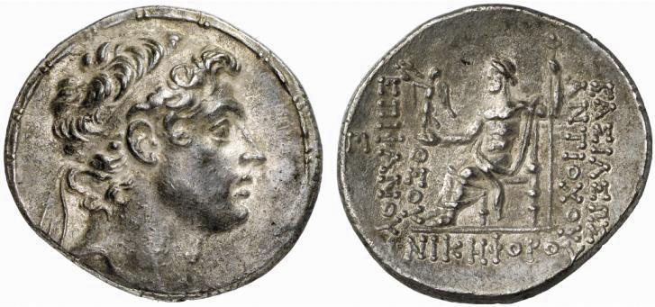
Antiochus IV Pollutes and Decrees ~By: Esther Sasson
According To Josephus He
Made His Decrees Because There
Was Fighting Amongst The Jews
According To Maccabees I, He Was Trying To Unify His Kingdom
No Brit Milah
No Shabbat
No Keeping Jewish Torah
He Sacrificed A Pig On The Mizbeach
He Brought Idles Into The Beit Hamikdash
He Polluted The Temple In 164 BCE

Slide 16
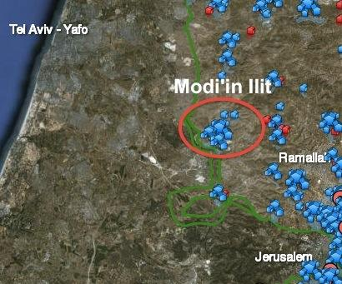
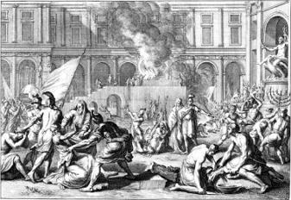
Matityahu and Sons - by: Sari Haddad
Matityahu and sons flee to Modiin from Jerusalem.
5 sons: John, Simon, Judah, Elazar, Jonathan
15th Kislev 168 B.C.E. Antiochus puts idols in B”H.
25TH Kislev 168 B.C.E. hogs were sacrificed on the altar.
Matityahu saw a Jew going to do a sacrifice (Antiochus wanted) and took action.
Matityahu ran up killed the Jew on the altar along with the king’s officers.
Matityahu was zealous, he fought for what he believed in.
The Jews were hiding.
The Greeks attacked the Jews,many people died.
Matityahu and Jews made a rule that Jews are allowed to fight on Shabbat.

Slide 17
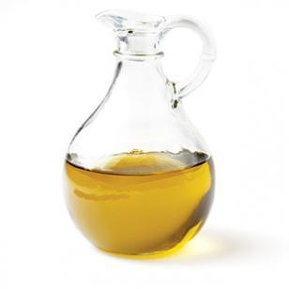
Purifying Of The Temple
The time period was on the 25 of kislev in 165 BC.
The temple was polluted by the greeks.
Hanukkah means dedication in hebrew and reminds of the rededication of the temple.
The syrian greeks wanted the temple to be for Zeus.
Mattityahu started the rebel against the greeks.
After the jews defeated Antiochus judah the Maccabee they went to the temple to light the menorah they found the temple impure.
For the jews to celebrate hanukah they destroyed the idols that the greeks brought in the temple also had to take out the altar and took the stones out and made new holy dishes and a new pure altar.

Slide 18
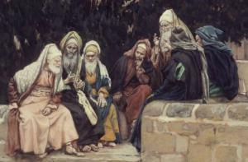
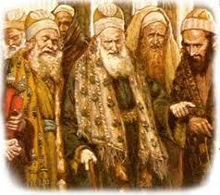
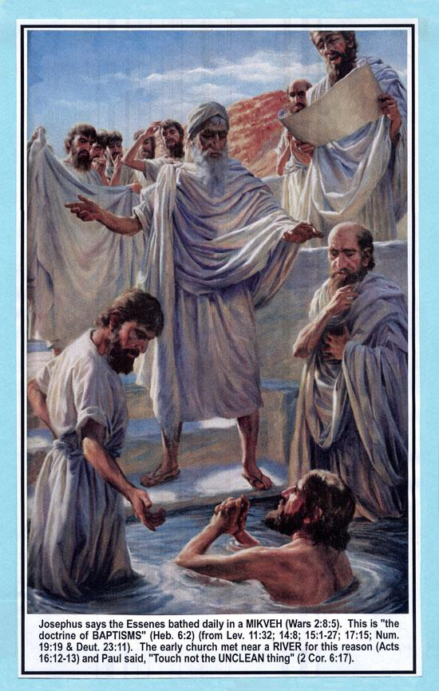
The Essenes
Pharisees
Sadducees

Slide 19
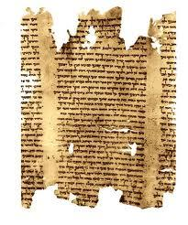
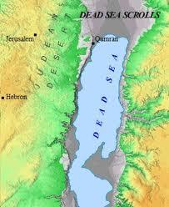
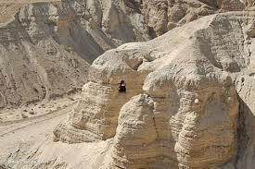
The Dead Sea Scrolls, by: Lillian B
-They were found in Qumran,by a bedouin boy between 1946-1956.
-They were written in mostly hebrew, and when they were found (about 900), some were in a bunch of little pieces that the scholars had to put together.
-These scrolls are a valuable source of primary information on the jewish sect that lived during the second temple period.

Slide 20
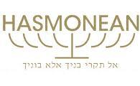
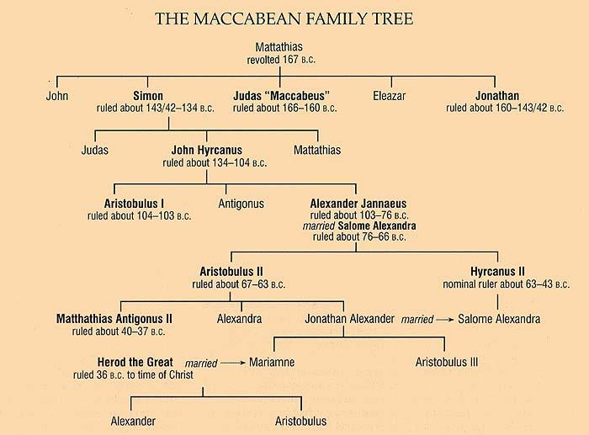
Hasmonean Dynasty
By: Lorite Abouhamra

Slide 21
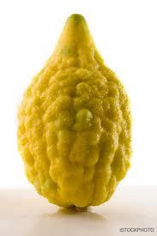
Hasmonean dynasty
Shimon the last surviving son of matityahu became high priest, nasi of jewish people making these offices hereditary.
Shimon son JohnHyrcanus continued territorial expansion and force the Idumean to convert to Judaism, he shifted from pharisees to sadducees.
his son Aristobulus was the first hasmonean to title himself “king”. continued the policy conquest but imprisoned his mother and brothers whom he didnt trust
his brother AlexandeYanna succeeded him. He conquered mostly all the coast cities and some greek cities in Transjordan. He had open conflict with pharisees, killing many after they pelted with an etrog during Sukkot holiday in the temple.

Slide 22
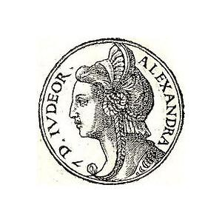
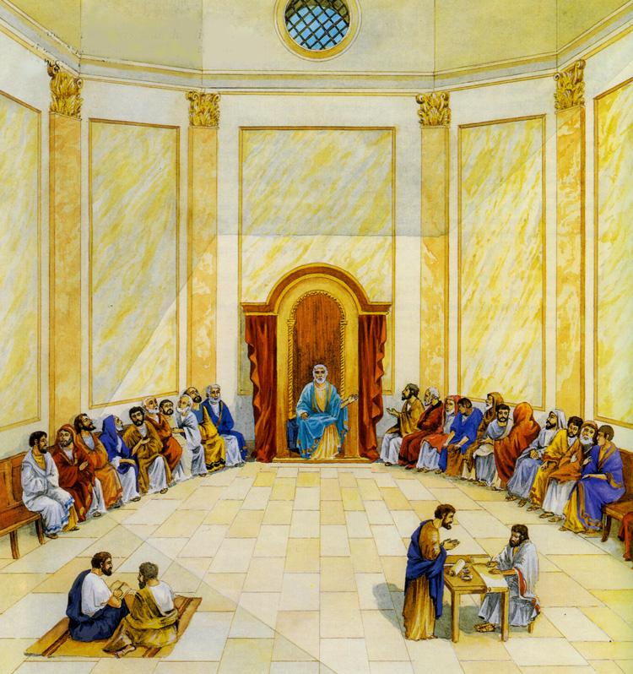
Salome Alexandra
She put her brother Shimon ben Shetach as leader. He was one of the Zugot
To make peace with the Pharisees she gave them power.
Because she was a Jewish leader she encouraged torah schools.
She was the last woman leader of judea, and the last ruler to die ruling over an independent kingdom.

Slide 23
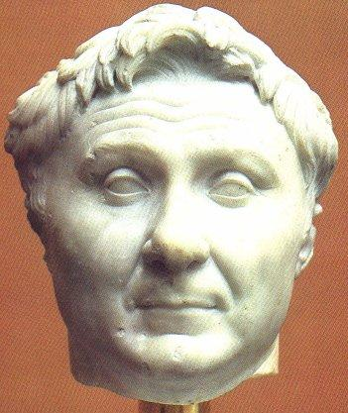
hyrcanus vs aristobulus
salome had two sons who fought for the leadership of the jews
they both ask pompey the roman general to help them
Sure i will help! the perfect opportunity to gain control of Judea.
63 BCE Judea becomes a consul to the Roman Empire.

Slide 24
thanks for watching
to be continued….

